Slide 1
Predicting H1N1 Vaccine Uptake
Machine Learning Insights for Public Health Decision-Making
Goal:
Use survey data to understand the factors influencing vaccination
and help public health organizations improve vaccination outreach.

Slide 2
Public Health Problem
During the 2009 H1N1 pandemic( swine flu), vaccination was the most effective tool
to control the spread of the virus.
However, many individuals chose not to vaccinate.
Public health organizations need to understand:
• Why some people vaccinate
• Why others hesitate
Machine learning can help identify the strongest predictors of
vaccination behavior.

Slide 3
Dataset Overview
Source: National 2009 H1N1 Flu Survey
Dataset contains:
• 26,000+ individuals
• Demographic characteristics
• Preventive behaviors
• Vaccine perceptions
• Doctor recommendations
Target variable:
Whether the respondent received the H1N1 vaccine.

Slide 4
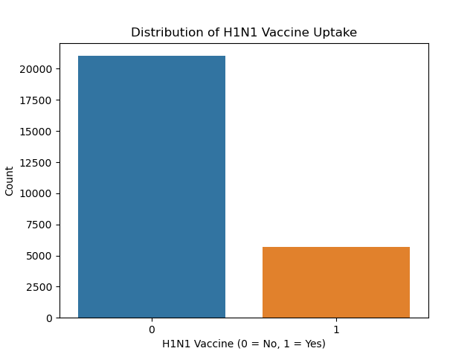
Vaccination Distribution
This chart shows the distribution of individuals who received the vaccine.
Observation:
Most individuals in the dataset did NOT receive the vaccine.
mplication:
The dataset is imbalanced, meaning the model must carefully distinguish
between vaccinated and non‑vaccinated individuals rather than simply
predicting the majority group.

Slide 5
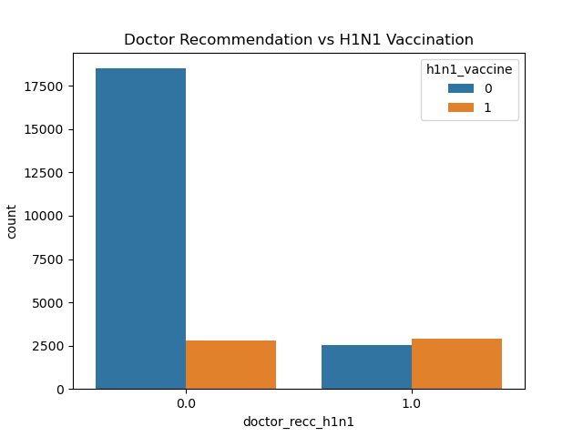
Impact of Doctor Recommendation
This visualization compares vaccination rates between people
who received a doctor recommendation and those who did not.
Observation:
Individuals whose doctors recommended the vaccine were
significantly more likely to vaccinate.
Implication:
Healthcare professionals play a critical role in influencing
vaccination decisions.

Slide 6
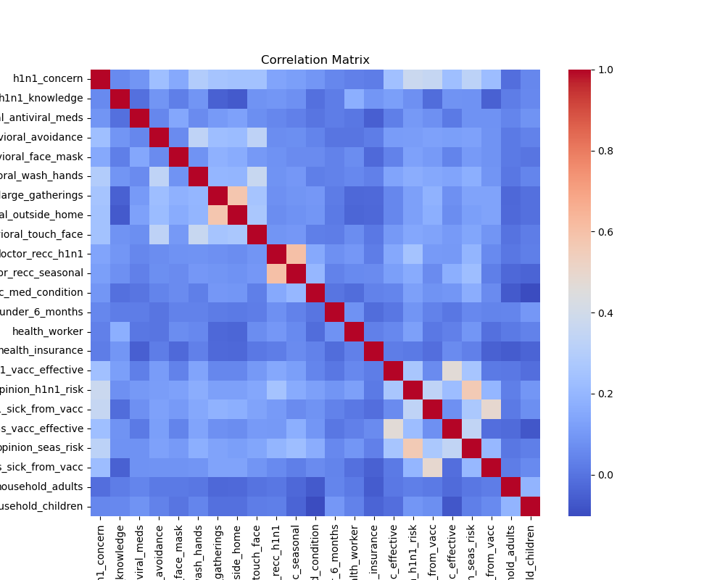
Correlation Between Variables
The correlation matrix shows relationships between variables.
Observation:
Most correlations are moderate rather than extremely strong.
Implication:
Vaccination behavior is influenced by multiple factors such as
risk perception, vaccine beliefs, and doctor recommendations,
rather than a single dominant variable.

Slide 7
Machine Learning Models
Three classification models were evaluated:
• Logistic Regression
• Decision Tree
• Random Forest
Evaluation metrics included:
Accuracy, Precision, Recall, F1‑Score, Confusion Matrix, and ROC‑AUC.
Goal:
Identify the model that best predicts vaccination behavior
while remaining interpretable for public health stakeholders.

Slide 8
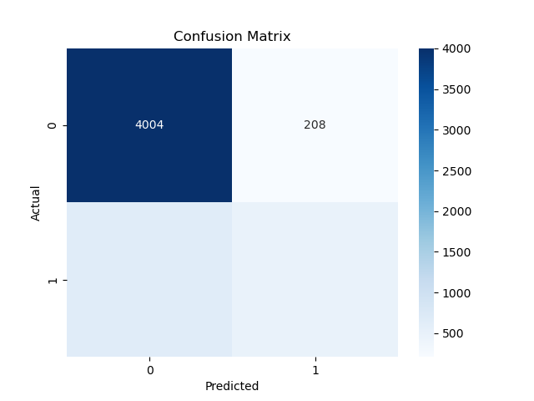
Confusion Matrix
The confusion matrix shows how well the model predicts vaccination.
Observation:
The model correctly identifies most individuals who did not receive
the vaccine, but it is less accurate in predicting vaccinated individuals.
Implication:
This occurs because fewer individuals in the dataset received
the vaccine, creating class imbalance.

Slide 9
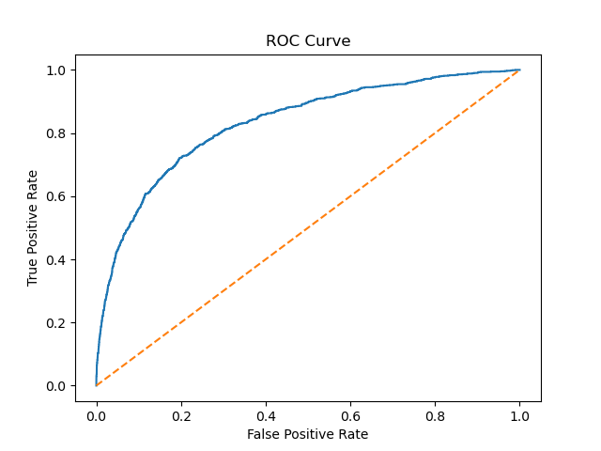
ROC Curve (Model Performance)
The ROC curve measures how well the model separates
vaccinated and non‑vaccinated individuals.
Observation:
The curve stays well above the diagonal line,
indicating strong predictive performance.
The AUC score of approximately 0.83 suggests the model
can effectively distinguish between the two classes.

Slide 10
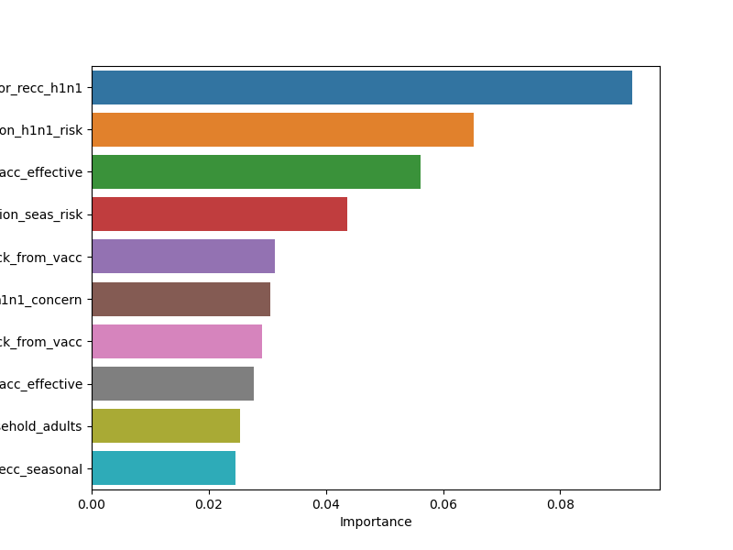
Key Predictors of Vaccination
Feature importance shows which variables most influence predictions.
Top predictors include:
• Doctor recommendation
• Perceived H1N1 risk
• Belief in vaccine effectiveness
• Concern about the virus
Implication:
Perceptions of risk and trusted medical advice strongly influence
vaccination decisions.

Slide 11
Key Insights
1. Doctor recommendation is the strongest driver of vaccination.
2. Individuals who perceive higher risk are more likely to vaccinate.
3. Healthcare workers show higher vaccination rates.
4. Older populations tend to vaccinate more often.
These patterns highlight the importance of trust in healthcare
providers and public health messaging.

Slide 12
Recommendations for Public Health
- Encourage healthcare providers to actively recommend vaccines.
- Increase public awareness of influenza risks.
- Develop targeted campaigns for populations with low vaccination rates.
- Expand workplace vaccination programs in healthcare environments.

Slide 13
Conclusion
Machine learning helps identify the key factors influencing
vaccination behavior.
Doctor recommendation, risk perception, and vaccine beliefs
were among the most important predictors.
These insights can help public health organizations design
more effective vaccination campaigns and increase uptake.

